Slide 1

HEALTH and SAFETY AWARENESS

Slide 2
OCCUPATIONAL HYGIENE TRAINING ASSOCIATION
The Occupational Hygiene Training Association (OHTA) is a UK based registered charity affiliated with a US based OHTA chapter that also has not-for-profit status.
The organization is made up of experienced Health & Safety volunteers with the goal of promoting better standards of occupational hygiene practice throughout the world.
We do this on a volunteer basis by:
Developing training materials and making them freely available for use by students and training providers.
Promoting an international qualifications framework so that all hygienists are trained to a consistent, high standard, recognized in all participating countries.
Working with other not-for-profit national and international organizations with goals similar to ours.
For more information, see our website at OHlearning.com.

Slide 3
PURPOSE of OHTA COURSE
This health and safety awareness training is intended as a general introduction to safety and industrial hygiene (occupational health) for persons who generally will not have primary responsibility for these programs, but are involved in their implementation.
It is intended to provide an overview of the issues and common solutions for persons such as supervisors and managers such that they can recognize some common hazards, understand the hierarchy of controls and know when to ask for technical help in resolving problems.

Slide 4
OHTA ACKNOWLEDGEMENTS
Zack Mansdorf Ph.D., CIH, CSP, QEP, Course Editor, OHTA
Chris Laszcz-Davis, MS, CIH, COH, FAIHA, AIC Fellow, OHTA Co-Chair, Contributor and OHTA slide deck reviewer
Marianne Levitsky, MS, CIH, ROH, Contributor, WHWB
Debbie Dietrich, MS, CIH, Contributor
Melissa Gould, CRSP, CHSC, Contributor, LMA
David Hiipakka, CSP, CIH, MPH, Contributor, OHSS
Ross Di Corleto, PhD, COH, Contributor, OHTA
Alan Leibowitz, CIH, CSP, OHTA slide deck reviewer

Slide 5
WAYS THIS COURSE CAN BE USED
Self Instruction-download the course and view it at your convenience
Instructor Lead - this course presented by an instructor who is knowledgeable in the course subject matter
To Produce Another Course - using the materials from this course to structure a course that includes information unique to your local situation, rules and requirements
As Part of a Larger Training Program - using the materials and the course as part of a large training effort in safety and health at work or part of other training

Slide 6

HEALTH and SAFETY AWARENESS

Slide 7
HOW THIS COURSE IS STRUCTURED
Slides and knowledge checks.
The slides are sequential, but each section can be taken independently
The emphasis of the course is on best practices
The course does not focus on rules or regulations that are country specific, but there are some refences to practices in the United States (example: Fire Classifications)
The course is designed to be completed in 2 to 4 hours.

Slide 8
COURSE CONTENT
Why Effective Safety & Health (S&H) Programs Are Important
S&H Program Elements
Worksite Analysis/Risk Assessment
Hazard Prevention & Control
Worker and Management Training
Chemical Hazards
Hazard Communication and GHS
Occupational Health
Biological Hazards
Bloodborne Pathogens
Noise and Hearing Loss Prevention

Slide 9
COURSE CONTENT (continued)
Heat Stress
Electrical Safety
Fire Safety
Confined Spaces
Compressed Gases
Walking and Working Surfaces
Machine Guarding
Forklift Safety
Cranes and Hoist Safety
Ergonomics
Personal Protective Equipment (PPE)
Situational Awareness

Slide 10
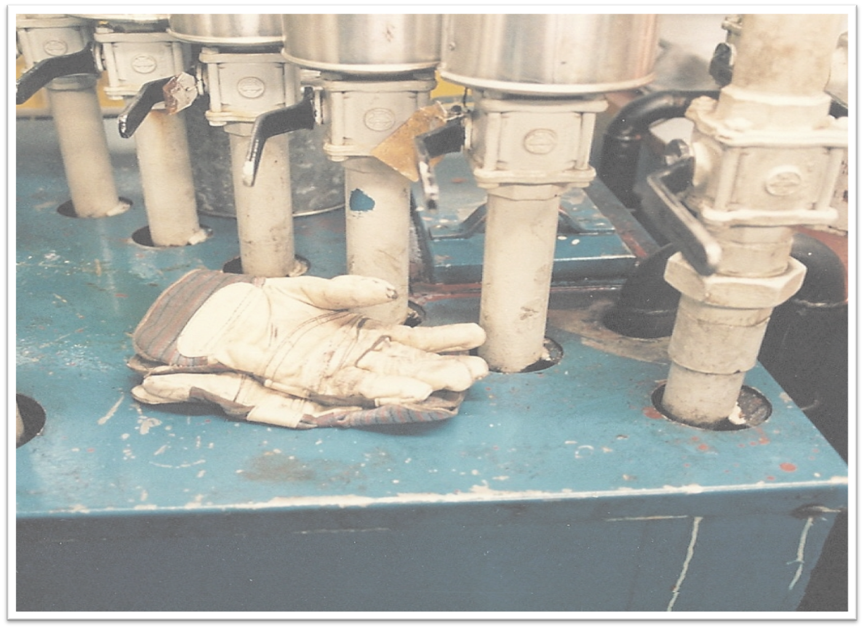
WHY SAFETY and HEALTH PROGRAMS are IMPORTANT

Slide 11

IMPORTANCE of EFFECTIVE SAFETY and HEALTH PROGRAMS
  Ensure workers go home as healthy as when they started work
  Reduce the extent and severity of work-related injuries and illnesses
  Improve employee morale, productivity & quality of life
  Strengthen operational practices
  Reduce costs

Slide 12

SAFETY and HEALTH PROGRAM ELEMENTS
SAFETY AND HEALTH MANUAL

Slide 13

SAFETY and HEALTH PROGRAM ELEMENTS
An effective occupational safety and health program will address the following four elements:
  1. Management commitment and employee involvement, including joint S&H committees
  2. Worksite analysis/ risk assessment of hazards
  3. Hazard prevention and control
  4. Safety and health training, including situational awareness

Slide 14

Management Commitment and Employee Involvement
Management commitment and employee involvement are critical:
  Management commitment provides the motivating force, direction and resources
  Employee involvement makes things happen operationally
  Both are necessary for an effective program
  Joint labor/management safety and health committees can be an effective way to help establish this partnership

Slide 15
KNOWLEDGE SELF-CHECK
Effective worker safety and health programs are important because they can (check all that apply):
Reduce the extent and severity of work-related injuries and illnesses.
Improve employee morale, productivity and quality of life.
Demonstrate a commitment to a healthful and safe work environment .
All of the above.

Slide 16
KNOWLEDGE SELF-CHECK
Effective worker safety and health programs are important because they can (check all that apply):
Reduce the extent and severity of work-related injuries and illnesses.
Improve employee morale, productivity and quality of life.
Demonstrate a commitment to a healthful and safe work environment.
X All of the above

Slide 17
SPECIFIC SAFETY and HEALTH
PROGRAM ELEMENTS
Worksite analysis/risk assessment
Accident/incident investigation
Facility inspection and hazard analysis
Hazard prevention and control
Medical surveillance
Worker and management training
Personal protective equipment (PPE)
Controls & procedures for specific hazards

Slide 18
EXAMPLES: CONTROLS and PROCEDURES for SPECIFIC HAZARDS
Occupational Health hazards
    Chemicals, hazardous materials, e.g. lead, silica
    Biological hazards, e.g. blood-borne pathogens, COVID-19
    Physical hazards, e.g. noise, heat
Ergonomic hazards
    Improperly adjusted workstations and chairs
    Frequent lifting
    Poor posture
    Awkward repetitive movements
    Having to use too much force
    Vibration

Slide 19
EXAMPLES: CONTROLS and PROCEDURES for SPECIFIC HAZARDS
  Safety hazards
    Forklift Safety
    Working and Walking Surfaces
    Machine Guarding
    Confined Spaces
    Compressed Gas Cylinders
    Electrical Safety
    Control of Hazardous Energy (Lockout/Tagout)
    Crane and Hoist Safety
    Elevated Work and other Fall Hazards
    Fire Prevention

Slide 20

WORKPLACE HAZARDS
We will discuss the majority of the items we have listed as hazards in more detail later in the course

Slide 21

WORKSITE ANALYSIS and RISK ASSESSMENT

Slide 22

WORKSITE ANALYSIS
Worksite analysis involves identifying existing hazards, as well as conditions, practices and operations which could create hazards
Risk assessment is the determination of the potential impact of the hazard and the likelihood of the hazard causing harm
It is a management responsibility to anticipate and eliminate or otherwise effectively control hazards

Slide 23
WORKSITE ANALYSIS
Conducting comprehensive baseline and periodic hazard surveys
Analyzing planned and new facilities, processes, materials and equipment to eliminate potential S&H hazards
Performing routine job hazard analyses
Investigating accidents and “near miss” incidents, to identify their causes and prevent them in the future
Analyzing injury and illness trends over time for patterns with common causes that can be identified and prevented

Slide 24
WORKSITE ANALYSIS
Worksite analysis for hazards includes an estimation of risk
What is the difference between hazard, harm and risk?
  Hazard = something that can cause harm if not controlled or eliminated
  Harm = What happens when the hazard is uncontrolled
  Risk = The combination of the probability (likelihood) that an outcome will occur, and the severity of the potential harm

Slide 25
RISK ASSESSMENT
WHAT IS HIGH and LOW RISK?
High risk - something that will cause great harm that is very likely to happen:
  Driving your car too fast in the rain with bald tires
Low risk - something that either will not cause much harm or is very unlikely to happen:
  Driving your car slowly on a residential street with good tires
Recap:
  Great harm and very likely=high risk
  Little harm and not likely to happen=low risk (usually acceptable)

Slide 26
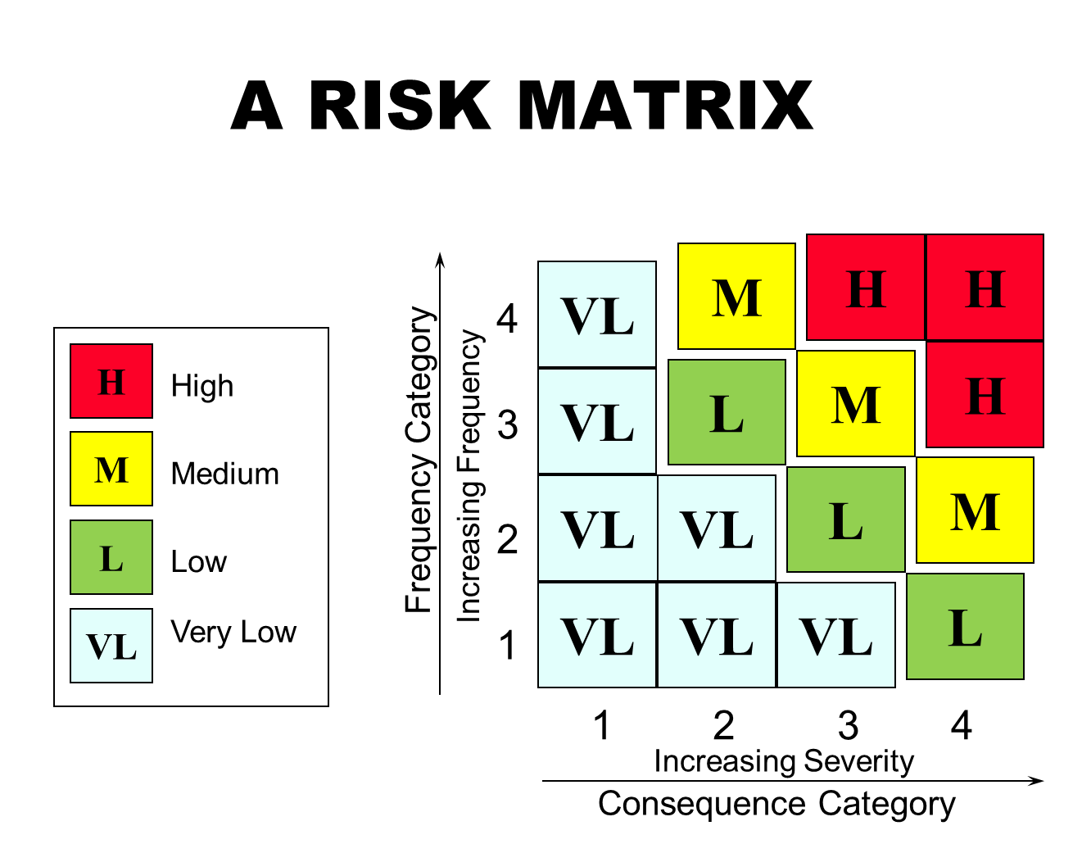

Slide 27
RISK ASSESSMENT
High Risk - an unguarded punch press must be corrected immediately
High Risk - storing a flammable solvent next to an open flame must be corrected immediately
Low Risk - work on an extra low voltage (<50 Volts AC) wiring system
Low Risk - most clerical work

Slide 28
EXAMPLES—RISK ASSESSMENT PROCESSES
Brainstorming potential hazards and outcomes with workers and management from the facility area being evaluated
Safety and Health Checklists
Job Safety Analysis (JSA) & Job Hazard Analysis (JHA)
Process Hazard Analysis (used commonly in chemical plant operations)
Ergonomic Hazard Analysis
Chemical Risk Assessment
Review by internal or external subject matter experts

Slide 29
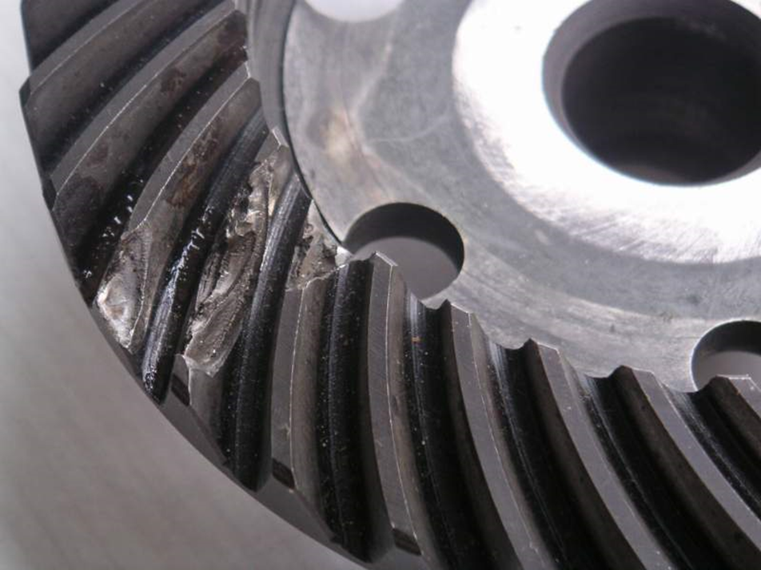
WHY DO ACCIDENTS HAPPEN?
Accidents occur for a variety of reasons
The next two slides will list typical reasons– both apparent direct causes and underlying root causes (we use root cause as the primary factor since there can be many)

Slide 30
Direct Causes of Accidents
Substandard Acts
Substandard Conditions
Operating equipment without authority
Failure to warn
Failure to secure
Operating at improper speed (rushing)
Making safety devices inoperative
Using defective equipment
Failing to use Personal Protective Equipment (PPE) properly
Improper loading
Improper placement
Improper lifting
Improper position for task
Servicing equipment in operation
Horseplay
Under influence of alcohol / other drugs
Using equipment improperly
Failure to follow procedure, policy, practice
Failure to identify hazard / risk
Failure to check / monitor
Failure to react / correct
Failure to communicate / coordinate
Inadequate guards or barriers
Inadequate or improper protective equipment
Defective tools, equipment or materials
Congestion or restricted action
Inadequate warning system
Fire & explosion hazards
Poor housekeeping / disorder
Noise, radiation, temperature exposure
Inadequate or excess illumination
Inadequate ventilation
Presence of harmful materials
Inadequate instructions / procedures
Inadequate information / data
Inadequate preparation / planning
Inadequate support / assistance
Inadequate communications hardware / software / process
Road conditions
Weather conditions
Notes:
Presenter highlight a few that are recurring Incident Causes for your plant / department / line
SCAT Chart can be handed out if helpful to Supervisors

Slide 31
Root Causes of Accidents
Personal Factors
System Factors
Inadequate mental / physical capability
Mental / physical stress
Lack of Knowledge
Lack of experience
Inadequate training
Misunderstood directions
Lack of Situational Awareness
Lack of Skill
Inadequate initial instruction
Inadequate / infrequent practice
Lack of coaching / review
Improper Motivation (Complacency)
Improper attempt to save time / effort
Improper attempt to avoid discomfort
Improper performance tolerated
Abuse or Misuse
Inadequate leadership / supervision
Inadequate engineering
  Inadequate risk assessment
  Inadequate consideration of ergonomics
  Inadequate or improper controls
  Inadequate evaluation of changes
Inadequate purchasing
  Inadequate ID of hazardous materials
  Inadequate contractor selection
Inadequate maintenance
  Preventative / Reparative
Inadequate tools and equipment
Inadequate work standards
  Development/Communication/Updating
Excessive wear & tear
Inadequate communications
Notes:
Presenter highlight a few that are recurring Incident Causes for your plant / department / line
SCAT Chart can be handed out if helpful to Supervisors

Slide 32

Analyzing Accidents and Near Misses
That Have Already Occurred
Accidents and Near Misses:
Identify the Direct Causes (substandard acts and conditions)
Identify the Root Causes (personal and system factors)
Good investigations will go beyond direct causes to identify the root causes.
When investigating, ask “why” five (or more) times!
WHY did she fall? She stepped on a banana peel.
WHY was the banana peel on the floor? It fell out of the trash.
WHY did it fall out of the trash? The can was too full and the lid unsecured.
WHY was the can too full? Maintenance missed a trash pick-up.
WHY was the schedule not followed? It was not documented and a new employee did not know to pick up that can daily.
ROOT CAUSE – Poorly documented and trained process.

Slide 33
KNOWLEDGE SELF-CHECK
Asking why the accident happened after each response (5 times) is a way to get at:
The root cause of the accident (e.g., lack of training)
Unsafe conditions (e.g., unguarded machine)
To get at the truth
All of the above.

Slide 34
KNOWLEDGE SELF-CHECK
Asking why the accident happened after each response (5 times) is a way to get at:
X The root cause of the accident (e.g., lack of training)
Unsafe conditions (e.g., unguarded machine)
To get at the truth
All of the above.

Slide 35

HAZARD PREVENTION and CONTROL

Slide 36

HAZARD PREVENTION and CONTROL
Triggered by a determination that a hazard or potential hazard exists
Where feasible, prevent hazards by effective redesign of the job or job site
Where elimination is not feasible, control or manage hazards to prevent unsafe and unhealthful exposure
Elimination or control must be accomplished in a timely manner

Slide 37
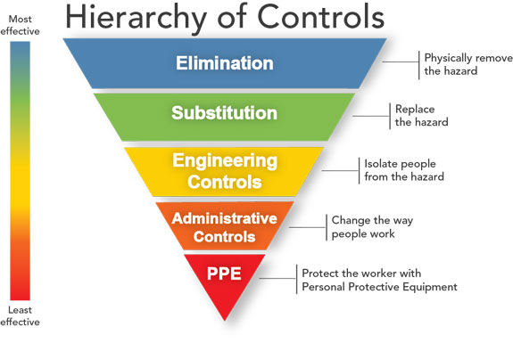
HAZARD PREVENTION and CONTROL

Slide 38
HAZARD PREVENTION and CONTROL
The best solution is always elimination or substitution which is at the top of the hierarchy of controls
Elimination
  Eliminate the hazard, such as moving a valve to ground level so that a ladder is not needed to open or close it
Substitution
  Using a significantly less hazardous material or approach such as substituting a non-flammable cleaning agent for one that is flammable

Slide 39
HAZARD PREVENTION and CONTROL
Timely correction or control of hazards includes:
  Engineering Controls, where feasible and appropriate, controlling hazards at the source using engineered systems (exhaust ventilation).
  Examples include:
    Local ventilation systems
    Process enclosure (Noise-hazardous equipment)
    Lock Out / Tag out of hazardous energy
    Machine guarding

Slide 40
HAZARD PREVENTION and CONTROL
Administrative controls include:
  Warning signs and labels: Must be properly communicated.
  Procedures for safe work : Standard job procedures are understood and followed as a result of training, positive reinforcement, correction of unsafe performance, and enforcement by supervisors
  For Example: Asbestos or mold removal work protocols
  Example: How to operate during normal operations, shut down, start up and during emergencies.
  Example: Work changes such as starting earlier in the day during hot seasonal work
  Example: Rotation of workers where the work is tedious

Slide 41

HAZARD PREVENTION and CONTROL
Timely control of hazards includes:
  Personal Protective Equipment (PPE): This should be a temporary measure until engineering or long-term controls are implemented where feasible.
  For example:
    Use of safety glasses and face shields for sight
    Use of ear plugs or muffs to protect hearing
    Use of respirators to protect the respiratory system
    Use of gloves and protective clothing for the skin
    Safety shoes and boots for protection of the feet

Slide 42

HAZARD PREVENTION and CONTROL
Other hazard prevention and control measures include:
  Facility and equipment maintenance to prevent failures
  Planning and preparing for emergencies such as severe weather
  Evaluating the need for first aid on site and the availability of emergency medical care nearby
Facility inspections
  Safety & health inspections using simple checklists developed by qualified persons
  Training workers to survey their own areas to report unsafe conditions

Slide 43
KNOWLEDGE SELF-CHECK
The Hierarchy of Controls is a model for handling identified hazards. The least effective measure in the Hierarchy of Controls is: (check all that apply):
Eliminate the hazard
Substitute a less hazardous material or approach
Provide engineering controls such as ventilation
Provide administrative controls such as work practices and rest breaks
Use personal protective equipment (PPE) such as respirators or hearing protection

Slide 44
KNOWLEDGE SELF-CHECK
The Hierarchy of Controls is a model for handling identified hazards. The least effective measure in the Hierarchy of controls is: (check all that apply):
Eliminate the hazard
Substitute a less hazardous material or approach
Provide engineering controls such as ventilation
Provide administrative controls such as work practices and rest breaks
X Use personal protective equipment (PPE) such as respirators or hearing protection

Slide 45

WORKER and MANAGEMENT TRAINING

Slide 46

WORKER and MANAGEMENT TRAINING
Training requirements vary by location and country but should include:
Training on the safety and health program and responsibilities of labor and management
Training on required controls and practices to protect themselves and their co-workers.
Training of management on their responsibilities to make sure required controls are in place and workers follow good safety practices

Slide 47
WORKER and MANAGEMENT TRAINING
Specific training on worksite hazards is covered in the next section and in other sections such as the section on personal protective equipment

Slide 48

CHEMICAL HAZARDS

Slide 49
CHEMICAL HAZARDS
All chemicals can be hazardous if used incorrectly
  Acetic acid at 5% is vinegar and used in your salad
  Acetic acid at concentrations above 10% can cause skin irritation or burns above 25%
Some chemicals are inherently more hazardous than others
  Gasoline is highly flammable and can be explosive if in a closed environment

Slide 50


CHEMICAL HAZARDS
Chemicals can present a variety of hazardous features including corrosivity, flammability, reactivity, toxicity, and others
We will feature human health effects in the next section

Slide 51

CHEMICAL HAZARDS
Chemicals can cause adverse health effects such as:
  Burns
  Permanent disabilities
  Death
Sometimes adverse effects occur immediately (Acute effect)
  For example – contact with corrosive chemicals can cause immediate skin burns
Sometime the adverse effects may not show for years or require long periods of exposure to show (Chronic effect)
  for example, years of exposure to silica can cause severe lung disease

Slide 52
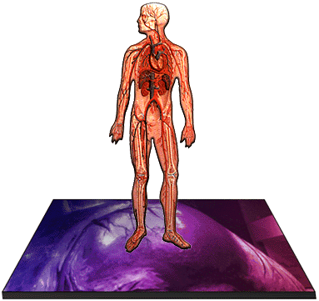
CHEMICAL ROUTES of ENTRY into BODY
Inhalation
Absorption
Ingestion
Injection

Slide 53
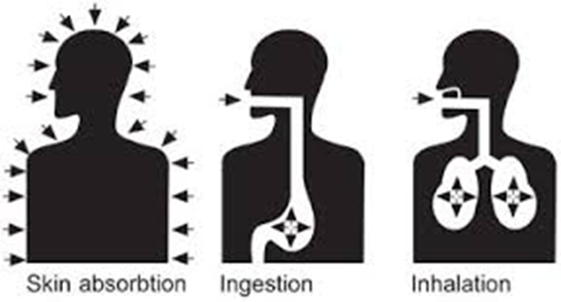
ROUTES of ENTRY into BODY
Inhalation-you breath in the substance such as the case with silica dusts. This can effect the nose, throat and lungs or even lead to systemic poisoning

Slide 54
ROUTES of ENTRY into BODY
Absorption-The substance permeates the skin or mucous membranes (e.g., eyes, mouth) and can enter the blood stream and lead to organ damage or systemic poisoning (e.g., nitroglycerin)

Slide 55
ROUTES of ENTRY into BODY
Ingestion-you inadvertently swallow the substance which leads to toxicity. Lead is an example of this route of entry from contaminated hands

Slide 56
ROUTES of ENTRY into BODY
Injection-an uncommon route of entry where the substance enters the body when the skin is punctured such as from a high- pressure hose or sharp object

Slide 57
SAFE HANDLING of CHEMICALS and HAZARDOUS MATERIALS
Chemicals and hazardous materials are potentially dangerous if not handled properly
  Know what you are handling
  Know the hazards associated with the material
  Know the measures you can take to protect yourself and others
  Handle all packages with care even though properly contained

Slide 58
KNOWLEDGE SELF-CHECK
Hazardous chemicals can produce both acute and chronic effects. What is an example of an acute effect from exposure (contact): (check all that apply):
Lung disease from silica exposure
Skin cancer from sun exposure
Chemical burn of the skin from an acid
Liver damage from low level solvent exposure

Slide 59
KNOWLEDGE SELF-CHECK
Hazardous chemicals can produce both acute and chronic effects. What is an example of an acute effect from exposure (contact): (check all that apply):
Lung disease from silica exposure
Skin cancer from sun exposure
X Chemical burn of the skin from an acid
Liver damage from low level solvent exposure

Slide 60
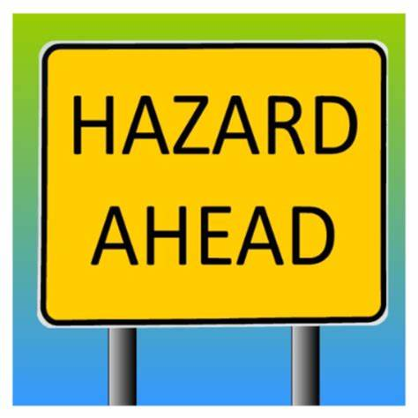
HAZARD COMMUNICATION and
GLOBALLY HARMONIZED SYSTEM (GHS)

Slide 61
MOST COUNTRIES REQUIRE WORLD-WIDE GHS* HAZARD COMMUNICATION SYSTEM
Purpose: communicate information about hazardous chemicals to employees so they can work safely
A hazardous chemical means any chemical which is a physical hazard (flammable, reactive, explosive, etc.) or a health hazard (exposure results in acute or chronic health effects)
Training should given to employees on the GHS upon initial employment and when new hazards are introduced into the workplace
*GHS = Globally Harmonized System of Classification and Labelling of Chemicals

Slide 62
ELEMENTS
HAZARD COMMUNICATION/GHS PROGRAMS
Materials Inventory
  A list of the hazardous materials present in the work area
Safety Data Sheets (SDSs)
  A detailed description of each hazardous material in the workplace
  GHS requires a specific SDS format
  Chemical suppliers are required to provide SDSs to customers
Labeling
  Identification of material within a container and warning of its potential hazards
Training
  How to identify and work safely with hazardous materials
Written Program
  One document which ties all of the above together

Slide 63





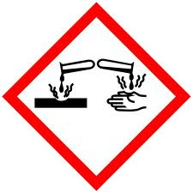



GHS and the HAZARD COMMUNICATION
GHS Pictograms: The pictogram on the label is determined by the chemical hazard classification
Carcinogen Flammables Irritant (skin and eye)
Mutagenicity Pyrophoric Skin Sensitizer
Reproductive Toxicity Self – Heating Acute Toxicity
Respiratory Sensitizer Emits Flammable Gas Narcotic Effects
Target Organ Toxicity Self – Reactive Respiratory Tract Irritant
Aspiration Toxicity Organic Peroxides Hazardous to Ozone
Skin Corrosion / Burns Explosives
Gases Under Pressure Eye Damage Self - Reactive
Corrosive to Metals Organic Peroxides
Oxidizers Aquatic Toxicity Acute Toxicity

Slide 64

LABELS, TAGS and MARKINGS
The employer should ensure that each container of hazardous chemicals in the workplace is labeled, tagged or marked with the following:
  Identity of the hazardous chemical
  Appropriate hazard warnings
Labels must be legible and prominently displayed

Slide 65
SAFETY DATA SHEETS (SDS)
Chemical safety data sheets (SDSs) contain information that includes chemical ID, physical characteristics, hazardous ingredients, health hazards, handling precautions, first aid, reactivity data and control procedures
The SDS will also detail recommended personal protective equipment, handling and storage recommendations and what to do in the event of a spill (“accidental release”)
The SDS has 16 sections and there is a lot more technical information provided
An SDS is required for every hazardous chemical on site and must be accessible to everyone

Slide 66
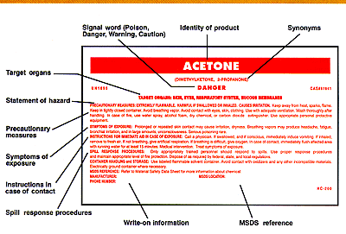
LABELS

Slide 67
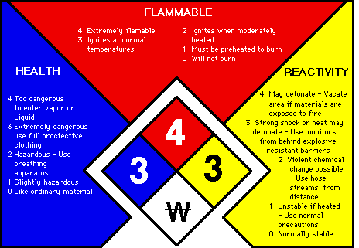
Some countries or places also use an NFPA (National Fire Protection Association) label
Specific hazard information

Slide 68


PERSONAL PROTECTIVE EQUIPMENT
Personal Protective Equipment (PPE) should be provided based on the SDS recommendations or use recommendations by site operations
PPE is not a substitute for engineering, work practice and/or administrative controls
Use of PPE does not eliminate the hazard, so if the equipment fails, then exposure occurs
PPE must be worn to provide protection

Slide 69
CHEMICAL STORAGE
Containers should be inspected periodically, and at least annually, to assure container and label integrity
Secondary containment (a spill pan) can prevent serious spills and subsequent reactions
All hazardous materials must be stored according to compatibility so that accidental mixing does not occur, such as not storing acids and bases next to each other. Applies to gas cylinders as well.

Slide 70

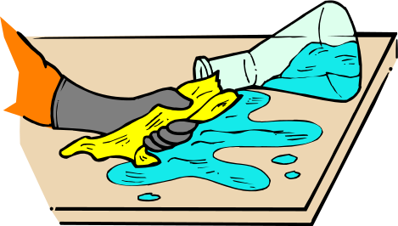
CHEMICAL SPILLS
Causes of chemical spills include:
  Inappropriate handling techniques;
  Inappropriate storage containers;
  Damaged storage containers;
  Uncontrolled access to chemical storage;
  Lack of chemical-related training; and
  Lack of supervision.

Slide 71
DANGERS of CHEMICAL SPILLS
Slip, trip, fall hazard
Contamination of other materials
Risk of fire
Possible hazardous chemical release to the environment

Slide 72
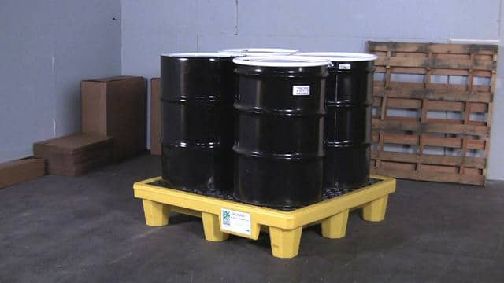
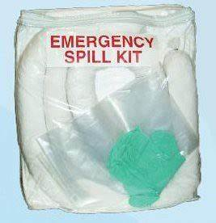
SPILL PREVENTION PLANNING
Only buy and store the amount of material needed
Buy the least hazardous materials possible
Use secondary containment for hazardous liquids (container to capture any leaks)
Minimize traffic in the area
Store liquid wastes in secondary containers
Regularly inspect containers to ensure integrity
Be aware of evacuation routes and emergency equipment

Slide 73
KNOWLEDGE SELF-CHECK
Every hazardous material used or stored at the worksite must have an SDS which all employees can have access to:
True
False

Slide 74
KNOWLEDGE SELF-CHECK
Every hazardous material used or stored at the worksite must have an SDS which all employees can have access to:
X True
False

Slide 75

OCCUPATIONAL HEALTH

Slide 76
OCCUPATIONAL HEALTH
Workers may be exposed to chemical, physical or biological hazards which could affect their health
  These hazard should be evaluated, If possible, by qualified S&H professionals, such as industrial or occupational hygienists or safety professionals
  The hazards should be quantified when possible, such as by air sampling for comparison to occupational exposure limits or recommendations.
  Hazards exceeding required or recommended exposure limits require action following the earlier Hierarchy of Controls strategy

Slide 77
OCCUPATIONAL HEALTH HAZARDS
General classes of occupational health hazards
  Chemicals – hazardous materials
  Biological: infectious disease and blood-borne pathogens
  Physical: vibration, noise, heat
Exposure to occupational health hazards may require medical surveillance to assure the health of the workers

Slide 78
MEDICAL SURVEILLANCE
Medical Surveillance of exposed workers
  Workers potentially exposed to certain hazardous agents may require periodic medical surveillance:
  Examples of exposures that may require medical surveillance include:
      Lead exposure
      Silica exposure
      High level noise exposure (may require annual hearing testing)
      Certain solvent exposures such as benzene
  Workers with abnormal results may have work restrictions or other requirements until more appropriate controls are implemented
  Medical surveillance may also be required with the use of certain types of personal protective equipment such as respirators

Slide 79

BIOLOGICAL HAZARDS

Slide 80
WHAT are BIOLOGICAL HAZARDS?
Biological hazards are those organisms and biological substances (e.g. allergens) that pose a threat to the health of people
  This can include blood-borne pathogens (most at risk are those in the medical profession), animal vectors, especially for animal handlers (mites, ticks and fleas), bacteria and fungi (e.g., black mold), infectious disease and others.

Slide 81
WHAT are BLOODBORNE PATHOGENS?
Infectious microorganisms in human blood that can cause disease in humans.
Examples: hepatitis B (HBV), hepatitis C (HCV) and human immunodeficiency virus (HIV).
Workers may be exposed by direct contact with body fluids or injuries from needlesticks and other contaminated sharp objects.

Slide 82

BLOODBORNE PATHOGENS
Do not touch or try and clean up any bodily fluids such as blood or vomit
A direct exposure to bodily fluids could result in contracting a bloodborne illness
Only trained employees with appropriate gloves & safety glasses should handle infectious materials

Slide 83
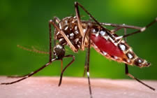
INFECTIOUS AGENTS
THAT CAUSE WIDESPREAD DISEASE
Infectious agents are organisms that are capable of producing infection or infectious disease. Examples of virus caused disease include Zika, COVID-19 and Influenza.
Zika Vector –Ades Species Mosquitoes

Slide 84
INFECTIOUS AGENTS that CAUSE WIDESPREAD DISEASE
Infectious agents have a long history of epidemics (local) and pandemics (global)
Our current experience with COVID-19 demonstrates that they can have the capacity to drastically alter our lives and work

Slide 85

EPIDEMICS (LOCAL)
  Smallpox
  Measles
  Polio
  TB
  Ebola
  MERS
Measles Virus (source CDC)

Slide 86

PANDEMICS (GLOBAL)
Pandemics have included:
  1346–1350: The Black Death
  1899–1923: Sixth cholera pandemic
  1918–1920: Spanish flu (H1N1)
  1957–1958: Asian flu (H2N2)
  1968–1969: Hong Kong flu
  2009–2010: Swine flu (H1N1)
  2020: COVID-19
COVID19: Source CDC

Slide 87
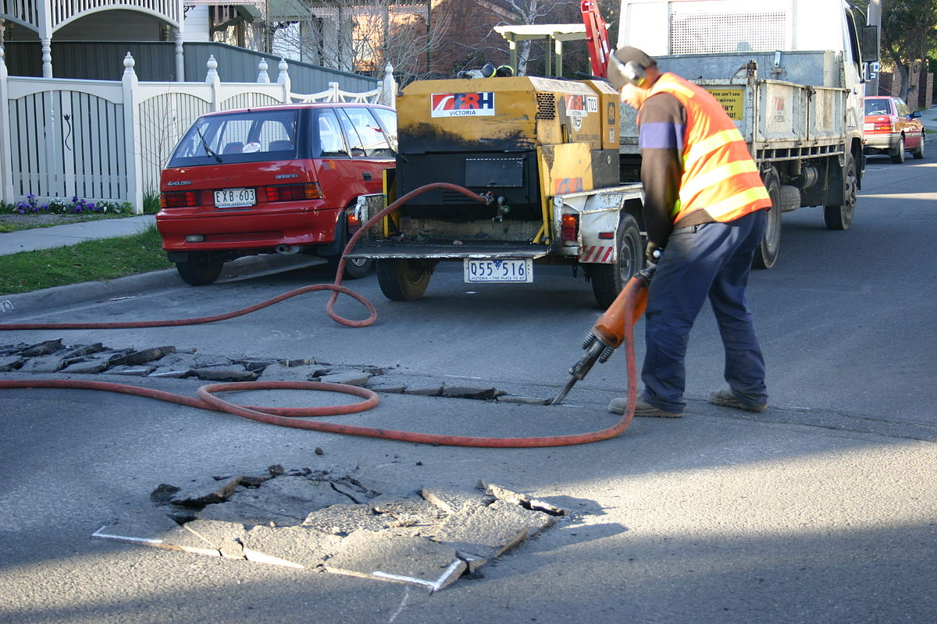
PHYSICAL HAZARDS

Slide 88
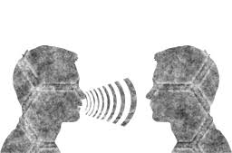
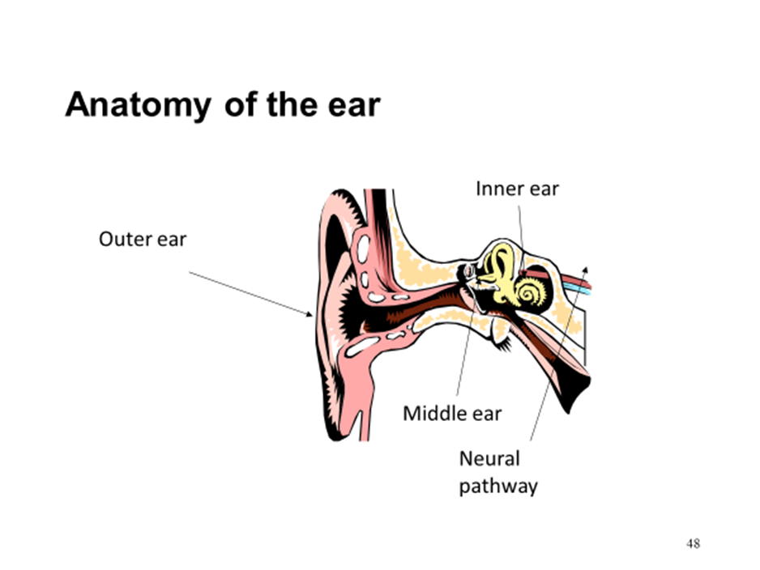
SENSORINEURAL
HEARING LOSS
Permanent damage to the inner ear and/or acoustic nerve
Painless “injury”
Gradual hearing loss
Cannot be corrected medically or surgically
Can affect ANYONE

Slide 89

NOISE INDUCED HEARING LOSS
Damage to the inner ear (usually permanent)
Significant change in hearing can occur
Usually difficulty understanding speech,
Sometimes includes ringing in the ear(s)

Slide 90
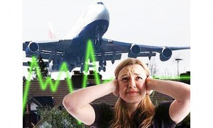
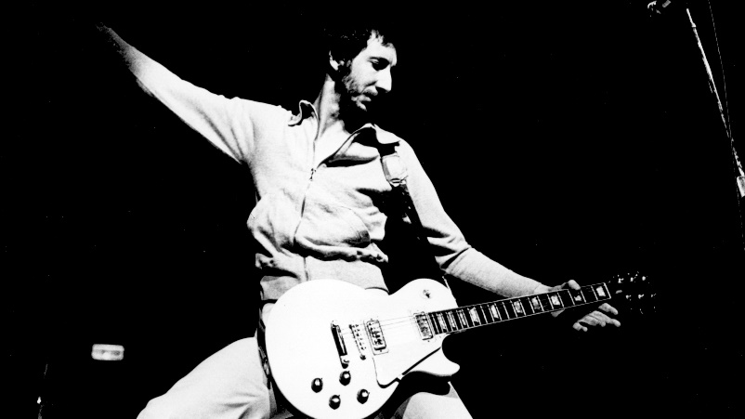
CAUSES of NOISE-INDUCED HEARING LOSS
Short bursts of very loud noise
Continuous exposure to loud noise

Slide 91

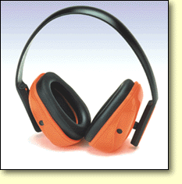
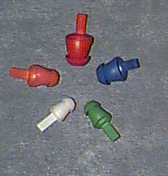
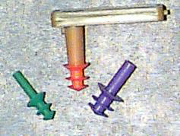
HEARING PROTECTION
Ear-muffs
Hand-formed plugs
Preformed plugs
  Single Flange
  Triple Flange

Slide 92
KNOWLEDGE SELF-CHECK
Hearing loss usually occurs suddenly
True
False

Slide 93
KNOWLEDGE SELF-CHECK
Hearing loss usually occurs suddenly
True
X False –most hearing loss is painless and gradual

Slide 94

HEAT STRESS

Slide 95

BODY’s REACTION to HEAT AFFECTED BY:
Environmental heat and humidity
Workload
Clothing
Individual personal factors (physical condition)
Heat strain is how the body responds to those stressors.
Symptoms include:
Sweating
Increased heart rate
Elevated core temperature
Various kinds of heat illness (heat stress) can result

Slide 96

ENVIRONMENTAL CONTRIBUTIONS to HEAT ILLNESS
  Temperature
  Humidity
  Air movement
  Radiant temperature of surroundings
  Clothing
  Physical activity
  Note that certain molten metal industries contribute high heat loads due to radiant heating (direct transfer of heat via infrared radiation)
Notes:
This overhead illustrates some of the environmental factors that must be considered.

Slide 97

PROGRESSION of EFFECTS
Initial symptoms are fatigue and lethargy
Increasing risk of heat disorders
Increasing rate of mistakes and accidents
Decreased performance and lower productivity
Notes:
Many people regard heat stress as when someone faints or collapses due to the heat. In fact if it has reached this point it has gone too far.
The first signs of heat strain show up as general fatigue, and lethargy.
This is then followed by decreased performance such a reduction in fine motor skills and coordination and a lowering of general productivity.
This then leads to lapses in concentration and an increase in mistakes and accidents. The US army also noticed that there was an increased incidence of injury during basic combat training in the summer months. To the point where the relative risk of suffering an injury was twice as high in summer than in the autumn.
A 2 to 3% loss in body fluid is generally regarded as the level at which there is an increased perceived effort, increased risk of heat illness and reduced physical and mental performance
If the symptoms are still ignored they then result in heat illnesses such as dehydration exhaustion and eventually heat stroke.

Slide 98
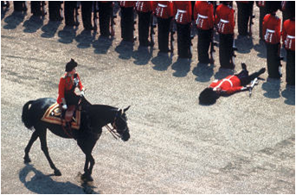
ACUTE HEALTH IMPACTS
Heat Cramps -painful muscle cramps, especially in abdominal or fatigued muscles
Heat Rash (prickly heat) -Itching skin, reduced sweating, skin rashes
Heat collapse- fainting
Heat exhaustion - high pulse rate, profuse sweating, low blood pressure, insecure gait (walk), pale skin, collapse
Heat Stroke - red face, disorientation, hot dry skin (usually no sweating), erratic behavior, collapse, shivering, unconsciousness, convulsions, body temp > 40◦C (104◦F)
  HEAT STROKE IS A MEDICAL EMERGENCY
Notes:
Heat Fatigue Temporary state of mental or psychological strain from prolonger heat exposure, decline in task performance, coordination, alertness.
Reduced by heat acclimatisation.
Heat rash (prickly heat) more likely to occur in hot humid environments, sweat is not easily removed from skin sweat ducts become plugged and causes rash Prevention: Cool breaks Regular bathing and drying of skin
Prickly heat sounds like a simple irritation to the skin, however, those that have experienced it describe it as agony. Common symptom in the army during training exercises (and likely in real situations). Out for a week or so, showers not necessarily provided, in hot, dusty/dirty conditions, working hard, carrying equipment. Sweat and dirt clog the pores in their skin and cause this rash.
Heat collapse (fainting) Non accustomed personnel in hot environments who stand upright and immobile. Drop in blood pressure & pooling of blood. Inadequate blood to heart to pump to brain. Prevented by keeping moving, correct hydration and acclimatisation program for new workers
Heat Cramps Painful muscle spasm that occurs when sweating profusely in heat Muscles being used are the most susceptible. Symptoms are relieved by drinking salty liquids or electrolyte/carbohydrate replacement fluids
Heat Exhaustion symptoms resemble heat stroke and include headache, nausea, weakness, thirst and giddiness caused by loss of large amounts of fluids by sweating, skin is clammy and moist, complexion is pale, body temperature is normal or slightly elevated
Symptoms are relieved by: resting in cool place, drinking plenty of fluids, severe cases could take several days to recover, no known permanent side effects
Other safety issues: Heat also promotes accidents: slipperiness of sweaty palms; dizziness; fogging of safety glasses; hot surfaces/steam – burns; lower mental alertness and individual physical performance; physical discomfort promotes irritability, anger and other emotions

Slide 99

FLUID REPLACEMENT
Thirst alone is an inadequate indicator
Rule of Thumb: Drink until thirst is satisfied, then have one more drink. Drink frequently.
Water is universally recommended, but sports drinks may also be acceptable
Pre and post-hydration is important when there are restrictions on drinking
Notes:
THIS IS PROBABLY THE MOST IMPORTANT OF ALL THE SLIDES IN THIS SESSION.
Most heat related illnesses are due to insufficient fluid intake.
Our thirst mechanism does not work as effectively as it should.
In order to ensure proper hydration, drink until the thirst is satisfied then have one more drink. Remember we are talking about water here!!! Water should be the main component of the drink but you can add cordial or juice if you like.
Coffee, tea and coke can be diuretics for some individuals though not as significant as once believed.

Slide 100
ACCLIMATIZATION
A complex physiological response that results in increased tolerance for working in hot conditions
May take a week or longer to develop
Is rapidly lost in part or whole when away from the conditions
As a general practice, reduce expectations during periods of acclimatization (work/rest intervals)
Notes:
As people become acclimatised the body produces a hormone called aldosterone. This hormone reduce the salt content in the sweat hence helping to conserve salt and it also increases the sweat rate to allow for more evaporative cooling. Hence a person who is unacclimatised may sweat less than someone who is acclimatised but they will probably loose more of their salts and electrolytes.
The 90 % acclimatisation level takes about 5 days (full acclimatisation in 2 weeks) and can be lost in about 4-5 days.
Hence a person that has been away from the area ie on holidays should be aware of their limitations for the first few days back and maintain your fluid and electrolyte balance.

Slide 101

STANDARDS for HEAT STRESS
Most countries have standards for exposure to heat
The exposure standards are typically based on estimated heat stress using a Wet Bulb Globe Temperature (WBGT). This instrument estimates heat stress
The higher the WBGT, the greater the need for rest between work periods (e.g., work 45 minutes, rest 15 minutes)

Slide 102
KNOWLEDGE SELF-CHECK
The correct order of increasing severity for heat stress is:
  heat cramps, heat stroke, heat rash, heat exhaustion
  heat cramps, heat rash, heat exhaustion, heat stroke
  heat stroke, heat exhaustion, heat rash, heat cramps
  heat exhaustion, heat stroke, heat rash, heat cramps
Noise induced hear loss can be fixed with surgery
  True
  False

Slide 103
KNOWLEDGE SELF-CHECK
The correct order of increasing severity for heat stress is:
  heat cramps, heat stroke, heat rash, heat exhaustion
  heat cramps, heat rash, heat exhaustion, heat stroke
  heat stroke, heat exhaustion, heat rash, heat cramps
  heat exhaustion, heat stroke, heat rash, heat cramps
Noise induced hear loss can be fixed with surgery
  True
  False

Slide 104

ELECTRICAL SAFETY

Slide 105

ELECTRICAL SAFETY
  The sections that follow are general rules and recommendations. Local requirements can vary between countries and within countries (e.g., in Europe most standard voltage is approximately 220V while it is 110V in the USA).

Slide 106
ELECTRICAL SAFETY
There are four main types of electrical injuries:
  Electrocution
  Electrical shock
  Burns
  Falls

Slide 107
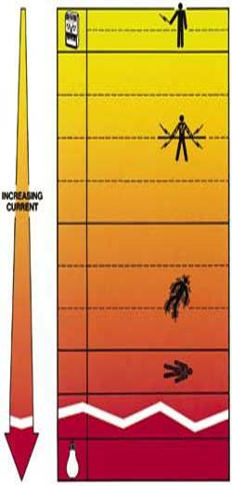
Dangers of Electric Shock in milliAmperes (mA)
(mA is a measure of the current)
1 mA | Perception level. Slight tingling sensation. Dangerous under certain conditions.
5 mA | Slight shock felt. Not painful but disturbing. Average individual can let go. Strong involuntary reactions to shocks in this range may lead to injuries.
6 mA to 30 mA | Painful shock, muscular control is lost. This is called the freezing current or "let-go" range.
50 mA to 150 mA | Extreme pain, respiratory arrest, severe muscular contractions. Individual cannot let go. Ventricular fibrillation (the rhythmic pumping action of the heart ceases) possible. Death is possible.
1000 mA to 4000 mA | Ventricular fibrillation likely. Muscular contraction and nerve damage occur. Death is likely.
> 4000 mA | Cardiac arrest. Severe burns. Death is probable.

Slide 108
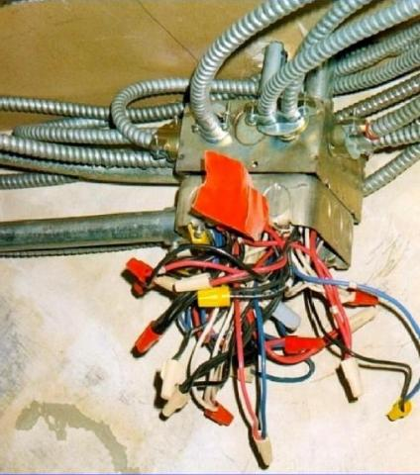
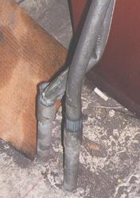
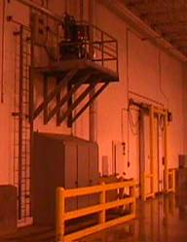
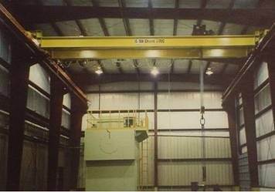
GUARDING LIVE PARTS
(General Standards which may vary by country)
Live parts of electric equipment operating at 50 volts or more must be guarded against accidental contact by approved cabinets or other forms of approved enclosures, or by any of the following means:
  By location in a room, vault, accessible only to qualified persons
  By permanent, substantial partitions or screens
  By location on a balcony or platform as to exclude unqualified persons
  By elevation of 8 feet or more above the floor or working surface

Slide 109
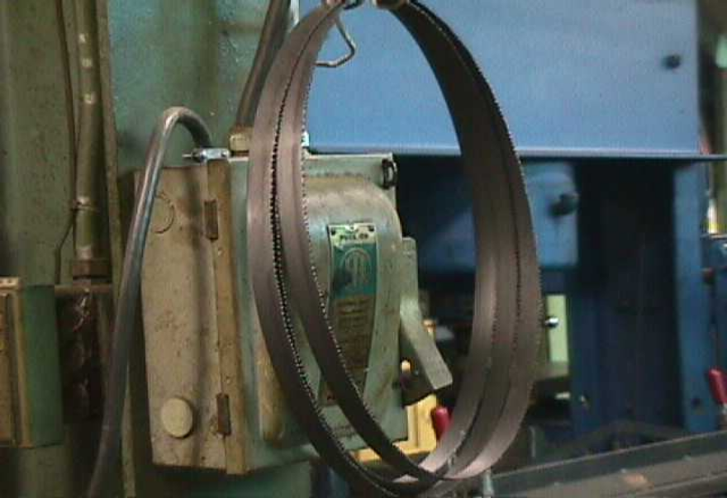
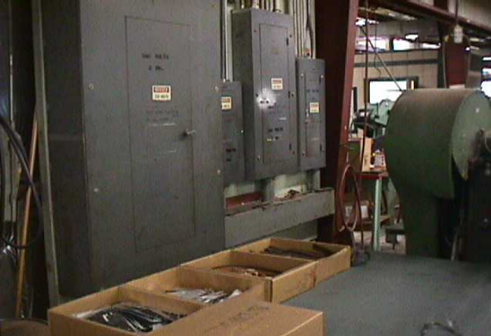
SPACE AROUND ELECTRIC EQUIPMENT
MUST BE MAINTAINED—NO STORAGE

Slide 110
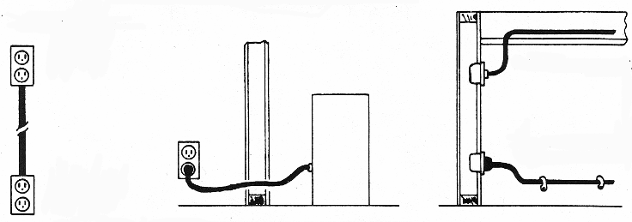
FLEXIBLE CORDS
Flexible cords and cables should not be used:
  As a substitute for the fixed wiring of a structure
  Where run through holes in walls, ceilings, or floors
  Where run through doorways, windows, or similar openings
  Where attached to building surfaces
  Where concealed behind building walls, ceilings, or floors
  Where installed in raceways, except as otherwise permitted

Slide 111
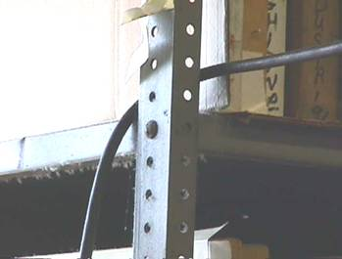
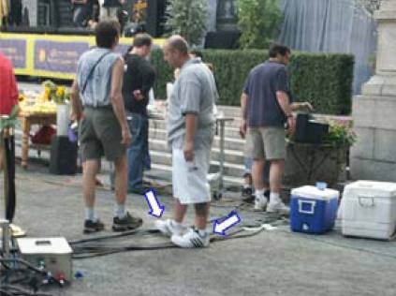
FLEXIBLE CORDS
Flexible cords and cables must be protected from accidental damage
  Sharp corners and projections shall be avoided

Slide 112
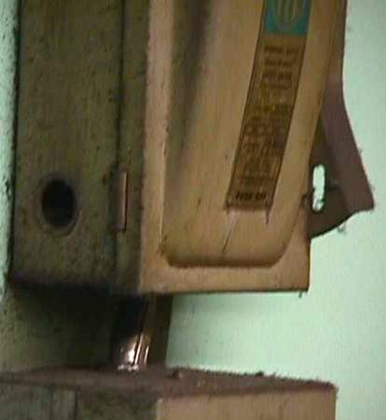
BOXES, CABINETS and FITTINGS
The knockouts in cabinets, boxes, and fittings should be removed only if conductors are to be run through them
Open knockouts and other holes must be closed

Slide 113

PROTECTIVE EQUIPMENT
Employees working in areas where there are potential electrical hazards should be provided with and use electrical protective equipment that is appropriate for the specific parts of the body to be protected and for the work to be performed
  Protective equipment should be maintained in a safe, reliable condition and shall be periodically inspected or tested

Slide 114
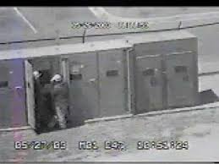
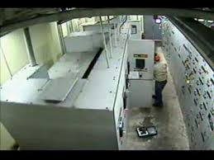
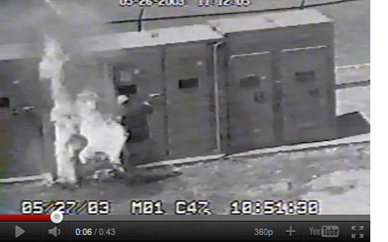
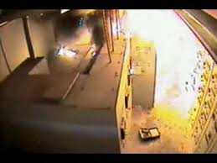
ARC FLASH HAZARDS
An arc flash can occur when electric current leaves its intended path and travels through the air from one conductor to another, or to ground. Arc flashes are violent and can result in serious injury or death.

Slide 115
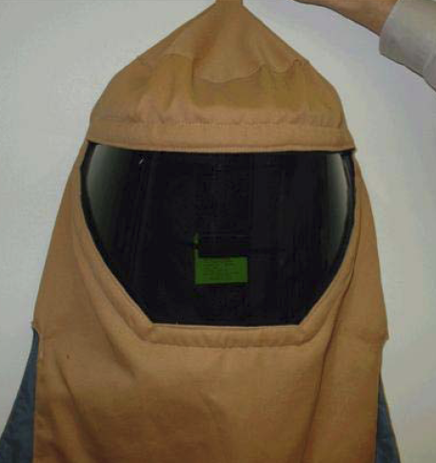
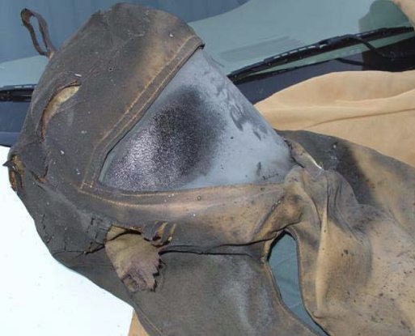
PROTECTIVE EQUIPMENT
BEFORE and AFTER ARC FLASH
Before
After

Slide 116

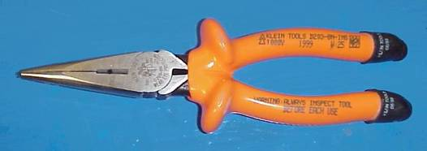
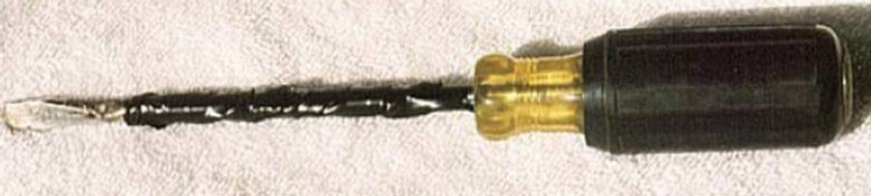
INSULATED TOOLS
When working near exposed energized conductors or circuit parts, each employee should use insulated tools or handling equipment if the tools or handling equipment might make contact with conductors or electrical parts

Slide 117
ELECTRICAL SAFETY PROGRAM ELEMENTS
    Ensuring appliances and equipment have the UL/EC or other certifying label
    Supervising extension cord use
    No overloading electrical circuits
    Ensuring Ground Fault Interrupter (GFI) devices are used where needed (moist environments, extension cords, etc.)
    Making sure all electrical equipment is properly grounded
    Wearing proper PPE (arc flash shields, certified gloves) where required
    Ensuring power is off before working on electrical devices
    If you are not sure and something appears wrong, asking for someone qualified such as an electrician
    Never bypassing fuses

Slide 118
KNOWLEDGE SELF-CHECK
As little as 50 mA could lead to a serious electrical shock:
True
False
Extension cords can be permanent if well designed in industrial settings:
True
False

Slide 119
KNOWLEDGE SELF-CHECK
As little as 50 mA could lead to a serious electrical shock:
X True
False
Extension cords can be permanent if well designed in industrial settings:
True
X False

Slide 120
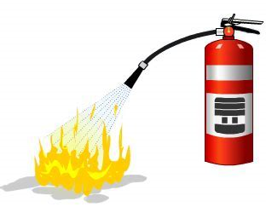
FIRE SAFETY

Slide 121
2 TYPES of FIRE HAZARDS
Common
  Likely to be found in almost all occupancies
  Not associated with a specific:
    Occupancy
    Process or activity
Special
  Arises from the process or operations taking place in the space
FIRE TYPICALLY REPRESENTS THE SINGLE GREATEST RISK TO WORKERS

Slide 122
TYPES of FIRES (USA CLASSIFICATION)
Class A
  Wood, cloth, paper, cardboard
Class B
  Flammable or combustible liquids, gases
Class C
  Energized electrical equipment
Class D
  Combustible metal

Slide 123
TYPES of FIRES (EU CLASSIFICATION)
Class A
  Wood, cloth, paper, cardboard
Class B
  Flammable or combustible liquids
Class C
  Flammable gases
Class D
  Combustible metal
Class K
  Electrical Fires

Slide 124
GENERAL FIRE SAFETY
Housekeeping-inside
  Storage and disposal of trash and debris to reduce any potential fuel for a fire
  Containers - selected by waste type
    General (non-combustibles)
    Smoking materials
    Oily rags (can spontaneous combust)
    Highly combustible materials such as flammables

Slide 125
HOUSEKEEPING
Keep areas near your work including outside areas
  Free of wastepaper
  Weeds
  Litter
  Combustible waste & rubbish

Slide 126
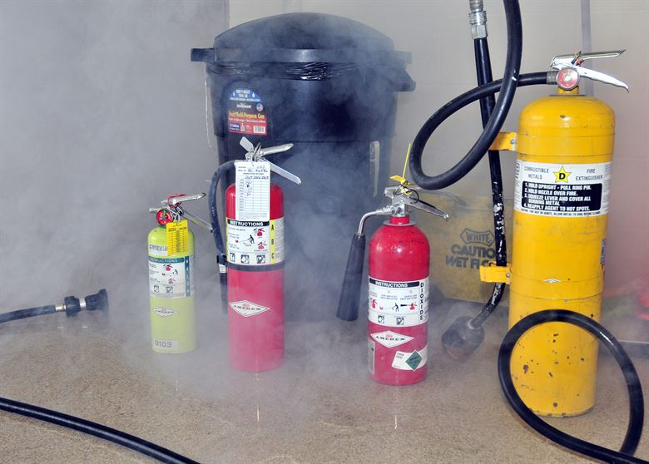
FIRE EXTINGUISHERS
Ratings
  Based on use by untrained operator
Class A
Class B
Class C
Class D

Slide 127
FIRE EXTINGUISHERS
Check the fire extinguishers to determine whether:
  In the proper location and accessible
  Discharge nozzle or horn are not obstructed, cracked or dirty
  Operating instructions on the nameplate are legible
  Lock pins and tamper seals are in place
  Extinguishers are full and ready for use
  Extinguishers have an inspection tag (normally inspected monthly)

Slide 128
FIRE EXTINGUISHER USE
Extinguishers have a limited range and amount of extinguishing agent. They are effective against small fires, BUT should not be used in any of the following:
You have not been properly trained to use the fire extinguisher
The fire spreads beyond its immediate area
The fire could block your escape route

Slide 129
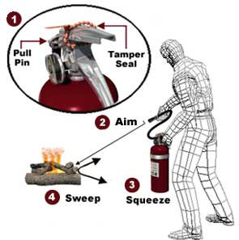
FIRE EXTINGUISHER USE
Discharge the extinguisher within its effective range using the P.A.S.S. technique (pull, aim, squeeze, sweep).
Back away from an extinguished fire in case it flames up again.
Evacuate immediately if the extinguisher is empty and the fire is not out.
Evacuate immediately if the fire progresses beyond the incipient stage.

Slide 130
KNOWLEDGE SELF-CHECK
If a fire can block your exit, you should immediately evacuate:
True
False
Class A fire extinguishers in most of the World are for chemical fires such as flammable liquids:
True
False

Slide 131
KNOWLEDGE SELF-CHECK
If a fire can block your exit, you should immediately evacuate:
X True
False
Class A fire extinguishers in most of the World are for chemical fires such as flammable liquids:
True
X False (Class A is for wood, cloth, paper and carboard fires)

Slide 132
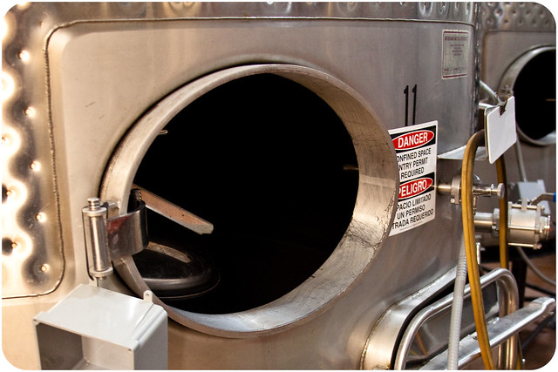
CONFINED SPACES

Slide 133

CONFINED SPACE GENERAL AWARENESS
Confined Spaces are defined as:
  Large enough for human occupancy
  Limited access and egress
  Not designed for human occupancy
Permit required (entry requires specific authorization) confined spaces are those which present a hazard to humans
  Typically identified by warning signage
Rules vary by country, but most require special permits for entering into potentially hazardous confined spaces

Slide 134
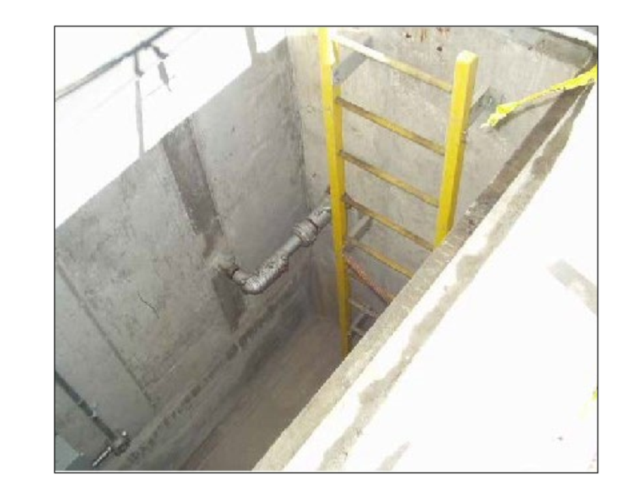
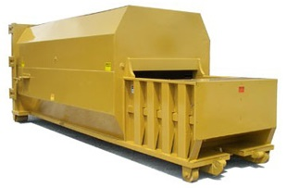

DIFFERENCE - STANDARD and PERMIT SPACES
Standard Confined Space
Permit Required Confined Space

Slide 135
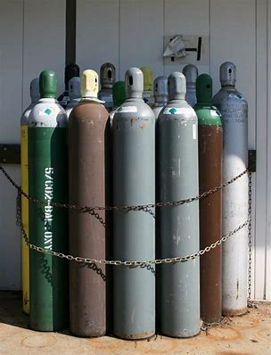
COMPRESSED GAS CYLINDERS

Slide 136
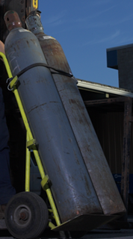
COMPRESSED GAS CYLINDER
HANDLING and STORAGE
Never accept compressed gas cylinders (CGCs) that were shipped in a horizontal position
Store CGCs upright
Keep CGCs secured
with chains or cables

Slide 137

COMPRESSED GAS CYLINDER HANDLING and STORAGE
Group cylinders by type of gas
Store full and empty cylinders apart
Store gases so that old stock is removed and used first
Do not store acetylene and oxygen together (or any fuel and oxygen)

Slide 138

COMPRESSED GAS CYLINDER
HANDLING and STORAGE
Keep protective caps
on stored CGCs
Prevent the dropping
or banging of CGCs
Don’t roll CGCs along
the bottom rim

Slide 139

COMPRESSED GAS CYLINDER HANDLING and STORAGE
Ensure that valves, hoses,
connectors, and regulators are in good condition and turned off when not in use

Slide 140


COMPRESSED GAS CYLINDER HANDLING and STORAGE
Empty CGCs must be labeled “MT” or “Empty”
Keep oil and grease away from oxygen
CGCs, valves, and hoses

Slide 141
KNOWLEDGE SELF-CHECK
Compressed gas cylinders can be rolled to their storage location
True
False

Slide 142
KNOWLEDGE SELF-CHECK
Compressed gas cylinders can be rolled to their storage location
True
X False-Never roll a gas cylinder, it could fall or be damaged. Use a gas cylinder cart or device to move them.

Slide 143

MACHINE GUARDING

Slide 144

MACHINE GUARDING
  Four Types of Guards
  Fixed
  Interlocked
  Adjustable
  Self-Adjusting

Slide 145

MACHINE GUARDING
Fixed Guards
  A permanent part of the machine
  Not dependent on any other part to perform the function
  Usually made of sheet metal, screen, bars or other material which will withstand the anticipated impact
  Generally considered the preferred type of guard.
  Simple and durable

Slide 146

MACHINE GUARDING
Interlocked Guard
  Usually connected to a mechanism that will cut off the power automatically
  Could use electrical, mechanical or hydraulic systems
  Should rely on a manual reset system

Slide 147
MACHINE GUARDING
Adjustable Guard
  Very flexible to accommodate various types of stock.
  Manually adjusted

Slide 148
MACHINE GUARDING
Self-Adjusting
  The opening is determined by the movement of the stock through the guard.
  Does not always provide maximum protection.
  Common complaint- reduced visibility at the point of operation.... “I can’t see what I’m doing!”

Slide 149

MACHINE GUARDING
This shows a pulley system which has a fixed guard to keep fingers and tools away from pinch points

Slide 150
BASIC PRINCIPLE of MACHINE GUARDING-Prevent guarding entry of body parts or clothing
Over
Under
Around
Through

Slide 151

TYPES of MECHANICAL MOTIONS
In-Running Nip Points, also known as “pinch points,” develop when two parts move together and at least one moves in rotary or circular motion, and occur whenever machine parts move toward each other or when one part moves past a stationary object
  Typical nip points include gears, rollers, belt drives, and pulleys

Slide 152
MACHING GUARDING REQUIREMENTS
One or more methods of machine guarding should be provided to protect the operator and other employees in the machine area from hazards
Guards should be affixed to the machine where possible and secured elsewhere if for any reason attachment to the machine is not possible
  The guard itself must not create a new hazard
Special hand tools for placing and removing material without the operator placing a hand in the danger zone can be used to supplement protection provided

Slide 153

MACHING GUARDING REQUIREMENTS
Revolving drums, barrels, and containers guarded by an enclosure which is interlocked with the drive mechanism, so that the barrel, drum, or container cannot revolve unless the guard enclosure is in place

Slide 154

FORKLIFT SAFETY

Slide 155




PERSONAL PROTECTION REQUIRED IN THIS AREA
EYE
PROTECTION
HEARING
PROTECTION
STEEL TOED
SHOES
MAKE SAFETY A HABIT

Slide 156


RESPONSIBILITIES
As a pedestrian:
  If possible, provide pedestrian walkways
  Always be aware of forklift traffic
  Yield to forklifts (they may not see you)
As a Forklift driver
  Always be aware of your surroundings
  Check for and yield to pedestrians
  Avoid driving backward or with obstructed vision

Slide 157

WALKING and WORKING SURFACES

Slide 158

WALKING and WORKING SURFACES
Slips and falls are accidents that are very easily avoided
  Require adequate footwear (e.g., no sandals)
  Be aware of your surroundings
  Provide adequate lighting for walking and work surfaces
  Housekeeping
    Quickly clean up spills especially coolants and oil
      Ensure clean, hot, soapy water is used along with a clean mop head
    Keep walkways clear of obstructions
    Do not permit uncovered hoses and electrical cords in walkways unless clearly marked

Slide 159

WALKING and WORKING SURFACES
  Maintenance
    Assure holes, cracks and uneven walking surfaces are fixed
    Provide anti-slip coatings for slippery areas
    Provide railings for stairs
  Observe ladder safety requirements
  Communicate all potential hazards to fellow workers

Slide 160

CRANES and HOISTS

Slide 161


CRANES and HOISTS
Cranes can lift loads and move then horizontally
Hoists can only lift and lower loads

Slide 162

CRANES and HOISTS
All cranes and hoists must have written weight limits clearly identified
Only trained and certified operators should operate cranes and hoists
Never place any part of your body under a raised crane load
Use a hoist to heavy parts and tools

Slide 163

HOIST at UPPER LIMITS
Operators must be trained not to run hoist’s hook up to its upper limits
Chain failures on hoists can result from hooks being run with force up to their upper limits.

Slide 164

ERGONOMICS

Slide 165
ERGONOMICS
Ergonomics is derived from two Greek words:
Ergon meaning work and
Nomos meaning principles or laws
Ergonomics = The Science of Work
Ergonomics is not a new science, although the term has become more common lately. The phrase was first coined in 1857

Slide 166

ERGONOMICS
Poor ergonomics can lead to work related Musculoskeletal Disorders (MSDs)
MSDs are caused or made worse by work methods and environment. They occur when the physical capabilities of the worker do not match the physical requirement of the job
Common MSDs:
  Tendonitis
  Epicondylitis (tennis or golfer’s elbow)
  Bursitis
  Trigger Finger, Carpal Tunnel Syndrome, Back Strain

Slide 167
WHAT CAN CAUSE MSDs?
Prolonged, repeated or extreme exposure to multiple work-related MSD risk factors. Risk Factors:
Repetition
Awkward Postures
Static Postures
Cold Temperatures
Excessive Force
Vibration
Compression
Inadequate Recovery
Notes:
What characteristics of a job put you at risk for developing an injury or disorder.
MSDs are associated with repetition, awkward or static postures, forceful exertions, excessive vibration and compression and cold temperatures.
A single risk factor or single occurrence of a risk factor does not usually lead to an injury.
Risk factors when present in combination (that is an awkward posture and vibration or cold temperature and compression) or when occurring over long periods of time such as 6 hours a day, regularly and with severity are likely to lead to MSD over time.

Slide 168


AWKWARD POSTURES
Postures outside neutral (between knees & shoulders)
Neutral is the optimal position of each joint providing the most strength and control.
Awkward or unsupported postures that stretch physical limits, can compress nerves and irritate tendons
Before: Lab technician tilts his neck forward to view the screen into a non-neutral posture. He also bends over resting on his forearms to write on the documents.
Ergonomic Improvement: Worker easily views the screen from a neutral posture. The workstation adjusts to accommodate different working heights and users. When standing, work should be about elbow height.

Slide 169



AWKWARD POSTURES
Postures outside of neutral
Examples of Awkward Postures:
  Repeatedly raising or working with the hand(s) above the head or the elbow(s) above the shoulder(s) for more than 2 hours per day
  Kneeling or squatting for more than 2 hours total daily
  Working with the back, neck or wrist bent or twisted for more then 2 hours per day
  Sitting with feet unsupported

Slide 170


FORCE = A strong physical exertion
Exertion = the tension produced by muscles and transmitted through tendons
Before: Three workers climb on refuse bin to dump laundry cart full of waste. They risk back strain and lacerations while tipping cart over to empty it.
Excessive muscle tension can contract muscles to their maximum capability which can lead to fatigue and possible damage to the muscles and other tissues.
Ergonomic Improvement: One worker easily dumps waste in half the time.

Slide 171
FORCE
Examples of forceful exertions:
  Lifting (standards vary by country)
    more than the approximately 50 pounds at any one time
    more than 25 pounds from a height below the knees, above the shoulders, or at arms length more than 25 times per day
  Pushing / pulling with more than 20 pounds of initial force for more than 2 hours per day
  Pinching (pencil type grip) an unsupported object weighing 2 or more pounds per hand for more than 2 hours per day
  Gripping an unsupported object weighing 10 pounds or more per hand for more than 2 hours per day

Slide 172

VIBRATION - Single Point
Hand and Arm exposure results from vibrating objects such as power tools.
Examples of vibrating tools:
Using vibrating tools or equipment that typically have high vibration levels for more then 30 minutes a day (chain saws, jack hammers, percussive tools, riveting or chipping hammers)
Using tools or equipment that typically have moderate vibration levels for more then 2 hours total per day (jig saws, grinders or sanders)
Before: Boat worker is exposed to vibration above the guidelines
Ergonomic Improvement: Lower vibration tool reduces vibration to safe levels

Slide 173


COMPRESSION = soft tissue is compressed between the bone and a hard or sharp object
Compression, from grasping or contacting edges like tool handles, can concentrate force on small areas of the body, reduce blood flow and nerve transmission and damage tendons and tendon sheaths
Before: Worker rests his wrists on the sharp tray edges. His wrist is extended into a non-neutral posture.
Ergonomic Improvement: Worker rests her wrists and forearms on a padded surface. Wrist and forearms are in a neutral position.

Slide 174
PERSONAL FACTORS that can CONTRIBUTE to MSDs
Age and Gender
Hobbies
Previous Injuries
Physical Condition
Medical conditions (diabetes and arthritis)
Pregnancy
Obesity
Medications
Smoking
Fatigue

Slide 175
AVOIDING MSDs
Work Smarter, Not Harder!
Work in neutral postures
Reduce excessive force & repetition
Keep everything in easy reach and at proper heights
Keep warm
Minimize static unsupported postures and pressure points
Use proper lifting techniques and lift aides
Ask for assistance with difficult tasks
Take micro-breaks (stand, stretch, change tasks)
Maintain a comfortable environment

Slide 176



ERGONOMIC PROBLEM AREAS YOU HAVE SEEN
Warehouse materials must be raised off the floor with shelving, to least knee level to minimize back injury risks

Slide 177
VALUE of GOOD ERGONOMICS
The anticipated benefits of good workplace design:
  Improved safety and health by reducing work-related injuries and disorders
  Improved comfort, morale and job satisfaction
  Improved productivity with reduced worker injuries and employee turnover
Notes:
Why is ergonomics important to you?
Ergonomics can help us reduce the physical stress on the body and eliminate many potentially serious, disabling work related injuries and illness by understanding the way we work.
When ergonomics is properly applied the result is a more comfortable worker with increased safety and health. Health workers are more likely to remain working therefore turnover rates tend to reduce.
Ergonomics cannot only make the workplace safer it can produce financial benefits such as reduced workers’ compensation costs and increased productivity.

Slide 178
KNOWLEDGE SELF-CHECK
Heavy lifts of more than 50 pounds (23 Kilos) are ok as long as they are not repeated to often
True
False

Slide 179
KNOWLEDGE SELF-CHECK
Heavy lifts of more than 50 pounds (23 Kilos) are OK as long as they are not repeated too often
True
X False-50 pounds is the maximum recommended weight and could lead to injury and may be difficult for some small persons. Furthermore, there is still risk at this weight even if not lifted too frequently.

Slide 180

PERSONAL PROTECTIVE EQUIPMENT
(PPE)

Slide 181

PPE GENERAL REQUIREMENTS
  Hazard assessment and equipment selection
  Identifying hazards that require PPE
    There should be documentation of the equipment selection (required in some countries)
  Selecting PPE should be based on
    Hazard assessment
    Proper fit
  Communicate selection decision to each affected employee

Slide 182
PPE GENERAL REQUIREMENTS
Training
  Everyone required to wear PPE should be trained to know at least the following
    When PPE is necessary
    What PPE is necessary
    How to don (put on), doff (take off), adjust and wear PPE
    Limitations of PPE
    Proper care, use and maintenance

Slide 183
EXAMPLES: Limitations of PPE
Safety Glasses are not fully sealed
  They are designed to provide impact protection and basic deflection of small airborne liquid and debris of a non-hazardous nature
  Goggles and face shields must be used with corrosive or hazardous materials
Ear plugs only work when properly inserted and worn at all times
  Improper insertion of the ear plug drastically reduces its Noise Reduction Rating (NRR)
  Not wearing them for as little as 10 minutes out of an 8-hour day is equivalent to a 50% reduction in their protective rating (NRR)
Gloves are designed to work with specific materials
  They are not universal and must be evaluated for their effectiveness for each task they will be used for

Slide 184

CARE of PPE
Inspect all PPE prior to each use
  If any part of your PPE is damaged, see your supervisor for a replacement
Store all PPE in a clean, dry and secure place
Earplugs should be frequently cleaned or replaced to prevent ear infections

Slide 185


SAFETY GLASSES

Slide 186

SAFETY GLASSES - Proper Fit
There should be no uncomfortable pressure points on the side of the head or behind the ears
The nose piece should be comfortable and contact your nose without pinching
You should be able to see in all directions without major obstruction
The overall weight of your safety eyewear should be evenly distributed between your ears and your nose so that frames sit comfortably on your face without distracting from tasks
Frames should fit close to the face without hitting your eyelashes. The space around the frames and your face should be less than a pencil width. Gaps of less than or equal to 6-8mm are preferred
Eyewear should stay in place when you move your head front to back and side to side

Slide 187

GLOVES

Slide 188





SELECTION OF GLOVES
Must Be Based On The Hazard
Gloves selection must be based on the hazards
Thermal (hot and cold)
Physical (grip strength, cut resistance, puncture resistance)
Chemical (permeation and degradation resistance)
Biological (provides an effective barrier to disease)
Radiological (provides shielding against radiation)

Slide 189
RESPIRATORY PROTECTION

Slide 190

PROGRAM REQUIREMENTS
Where respirators are required:
  Procedures for selecting respirators
  Medical evaluations
  Fit testing procedures
  Procedures for ensuring air quality and quantity for air supplied respirators
  Procedures and schedules for cleaning, disinfecting, storing, inspecting, repairing and discarding respirators
  Employee training in respirator use (routine use and emergencies) to include donning and doffing (put on and take off)

Slide 191

AIR-PURIFYING RESPIRATORS
Types of Filtration and Absorbents
Mechanical
Chemical
Combination
Gas Mask

Slide 192

AIR-PURIFYING RESPIRATORS
Disposable (single use normally)

Slide 193

AIR-PURIFYING RESPIRATORS
1/2 Mask (with chemical cartridges)

Slide 194


AIR-PURIFYING RESPIRATORS
Full-Face (FF) with chemical cartridges
Disposable
Reusable

Slide 195

AIR-PURIFYING RESPIRATORS
Powered Air Purifying Respirator (PAPR)

Slide 196

SELECTION of RESPIRATORS
Respirators (cartridges also) should be selected based on the contaminant and the physical state of the contaminant
  Gases
  Vapors
  Particulate
  Other

Slide 197

RESPIRATOR MAINTENANCE and CARE
Cleaning and Disinfecting Intervals:
  One user - As often as necessary to maintain sanitary condition
  Two or more users - Before being used by different user
  Emergency use - After each use

Slide 198
RESPIRATOR TRAINING
Employers should assure that each employee can demonstrate knowledge of at least the following:
  Why respirators are necessary
  How improper fit, usage, or maintenance can affect protection
  Limitations and capabilities
  Proper inspection procedures

Slide 199
RESPIRATOR TRAINING
Employers should ensure that each employee can demonstrate knowledge of at least the following:
  Proper donning and doffing procedures
  Proper seal check procedure
  Maintenance and storage
  Medical signs and symptoms of overexposure

Slide 200
RESPIRATOR TRAINING
Retraining should be done at least annually or when
  Changes in workplace or respirator use render the previous training obsolete
  Employees cannot demonstrate the proper use of respirators
  Training requirements can vary based on local regulations

Slide 201
Limitations of PPE
  PPE ALONE CANNOT PROTECT YOU AGAINST ALL WORKPLACE HAZARDS

Slide 202
KNOWLEDGE SELF-CHECK
People who wear respirators should be trained in recognizing the symptoms of overexposure in case the respirator fails
True
False

Slide 203
KNOWLEDGE SELF-CHECK
People who wear respirators should be trained in recognizing the symptoms of overexposure in case the respirator fails
X True
False

Slide 204
SITUATIONAL AWARENESS

Slide 205
WHAT is SITUATIONAL AWARENESS?
Situational awareness is taking responsibility for your own safety as well as others
Situational awareness involves:
  Being aware of your immediate surroundings
  The impact of your or other’s actions as it relates to the well-being of yourself and those around you
  Requires the use of knowledge from your experiences
  Proper training/education to accurately assess and determine your level of safety and risk

Slide 206

10 WAYS
TO IMPROVE SITUATIONAL AWARENESS
Learn to Predict Events
Identify Elements Around You
Trust Your Instincts
Limit Situational Overload
Avoid Complacency
Be Aware of Time
Begin to Evaluate and Understand Situations
Actively Prevent Fatigue
Continually Assess the Situation
Monitor Performance of Others

Slide 207
SUGGESTIONS and COMMENTS on this COURSE
Please send your suggestions or comments to OHTA
Our general website with lots of information is: https://w2.ohtatraining.org
To contact us, please email team@ohlearning.com

Slide 208

Congratulations on Completing the Course

